Slide 1
Broad Types of Actions
Create a navigable game board.
Planned for Sprint 3.
Populate the game board with objects based on a chosen scenario.
Planned for Sprint 5.
Implement combat logic, allowing for interaction between objects.
Planned for Sprint 6.
Implement basic enemy AI, allowing enemies to interact with the player.
Planned for Sprint 7.

Slide 2
Release Goals

Slide 3
Sprint 1
Product Owner: Billy Loveday
Scrum Master: Dane Reggia
Goals
Set up and practice Unity and C#
Set up collaboration tools
Slack
Trello
Github

Slide 4
Sprint 1
Accomplishments

Slide 5
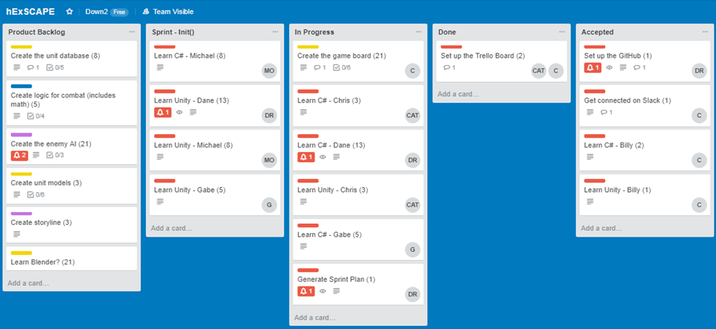
Sprint 1

Slide 6
Sprint 5
Product Owner: Gabe Mayo
Scrum Master: Michael Ouille
Goals
Dane: Movement functionality
Michael: Creating and saving user profiles
Gabe: Combat logic
Billy: Modeling and intro video
Chris: State controller

Slide 7
Sprint 5
Dane’s Accomplishments
Integrated Billy’s board code and his own.
Implemented Billy’s models and floating animation.
Spawned pieces on the board using Billy’s models.
Enabled movement functionality.

Slide 8
Sprint 5

Slide 9
Sprint 5
Michael’s Accomplishments
Completed GUI for profile completion form and profile view form.
Wrote scripts to save profile data to files.

Slide 10
Sprint 5

Slide 11
Sprint 5
Billy’s Accomplishments
Rendered animation videos.
Created the town model.

Slide 12
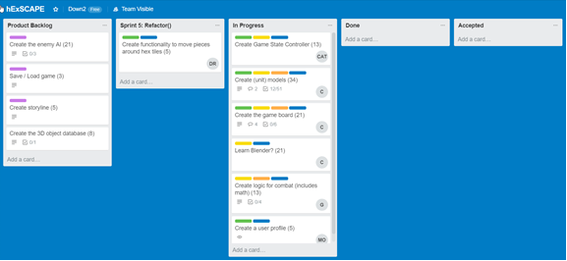
Sprint 5

